Slide 1
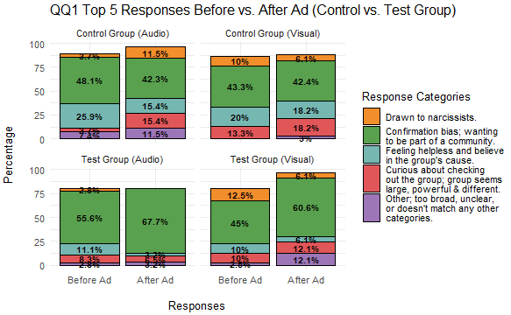
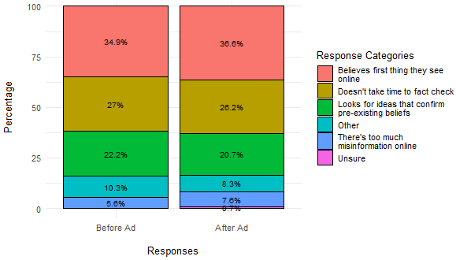
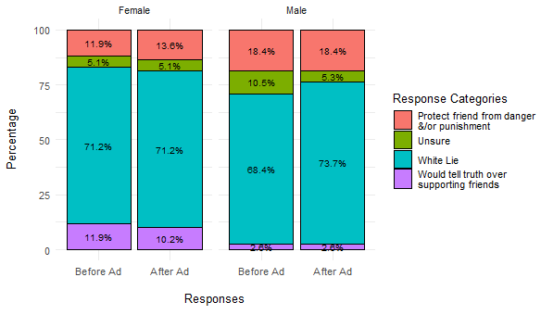
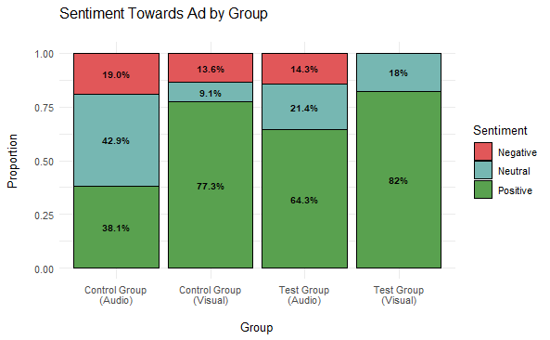
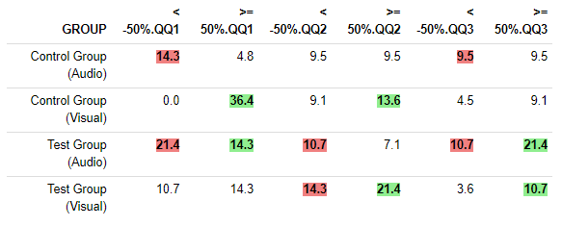
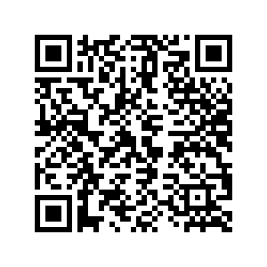

Non-Cognitive Predictors of Student Success: A Predictive Validity Comparison Between Domestic and International Students
Non-Cognitive Predictors of Student Success: A Predictive Validity Comparison Between Domestic and International Students
Combating Misinformation with a Humorous Audio Ad: Extending a Mixed Methods Analysis
PARTICIPANTS
Gender
Female: 59.6%
Male: 46%
Prefer not to say: 2%
Ages
18-19 years old: 24.2%
20-29 years old: 69.7%
30+ years old: 6.1%
Podcast habits
Listens to at least 1 podcast: 47.5%
Does not listen to any podcasts: 52.5%
Ad Skipping Behavior of Podcast Listeners:
Always skips ads: 71.8%
Sometimes skips ads: 26.8%
Never skips ads: 1.4%
RESULTS
Figure 1.
QQ1 Top 5 responses (out of 9) by ad group, before and after ad
Kendall Beaver¹, Diana Daley², Kainan Jarrette³
¹Graduate Researcher, College of Information Science
²Ph.D., Associate Professor, College of Information Science
³Undergraduate Research Assistant, College of Science - Psychology
QUESTIONS
Qualitative Questions (QQ)
QQ1: What are some reasons you think people are attracted to radical groups?
QQ2: What are some reasons you think people believe false ideas circulating online?
QQ3: Describe a situation in which supporting friends would be more important than telling the truth.
Questions About Ad
What did you like most about the ad?
What did you like least about the ad?
Please tell us any other thoughts you have about the ad.
BACKGROUND
Dr. Daley & Kainan developed a humorous audio ad with the goal of making a listener more skeptical about misinformation and information literacy
The ad was split into an audio and visual-audio format for a test group, while a random ad was presented in the same formats for a control group
99 college students participated in the study and were randomly assigned 1 of the 4 ads
Participants took tests before and after the ad that measured their tendency to believe misinformation: Generic Conspiracist Beliefs Scale and two Misinformation Susceptibility Tests (MIST-20 and IT-MIST)
Comparison of test results found that audio-visual ads led to improved information literacy while audio-only ads produced mixed results
Figure 2.
QQ2 responses with all ad groups, before and after ad
Figure 3.
QQ3 responses split by female and male, before and after ad
DISCUSSION
QQ1: 9 main categories were discovered, where the category of “wanting to be part of a community” increased at least 21% for the test group whose ads portray a female character becoming friends with an online radical group (Fig. 1)
QQ2: 6 common answers that remained about the same before and after ad (Fig. 2)
QQ3: Females had a significantly higher tendency (325%) than men to “tell the truth over supporting friends”, while males were 44% more likely to “protect their friends” than females (Fig. 3)
Sentiment analysis: Participants had a the largest negative feeling towards audio-only ads (19.0% and 14.3% for the control and test ad, respectively), while the test audio-visual ad had the largest positive sentiment of 82%, with no negative sentiment, indicating that people prefer this format the most (Fig. 4)
Composite score: The largest increase in written responses increasing >= 50% was the visual-audio control ad for QQ1, at 36.4% (Table 1)
Figure 4.
Sentiment towards ad by ad group
PROJECT OBJECTIVE
The researchers asked the several open-ended questions before and after the ad about misinformation, but did not have time to thoroughly analyze all of this data when study was published
Graduate researcher performed thematic and content analysis on this data and developed a composite score that measured the percentage change in a participant’s responses after viewing an ad
Results found that the format and content of ad may have subtly influenced the change in responses, but not consistently across all questions
Gender differences also revealed contrasting viewpoints in responses
Table 1.
Composite score of written responses for QQ1-QQ3, with a difference of + 50% in amount of words and sentences

